Slide 1
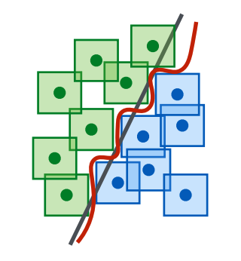
Adversarial Defense
姜育刚，马兴军，吴祖煊

Slide 2

Recap: week 4
1. Adversarial Example Detection
Secondary Classification Methods (二级分类法)
Principle Component Analysis (主成分分析法，PCA)
Distribution Detection Methods (分布检测法)
Prediction Inconsistency (预测不一致性)
Reconstruction Inconsistency (重建不一致性)
Trapping Based Detection (诱捕检测法)

Slide 3
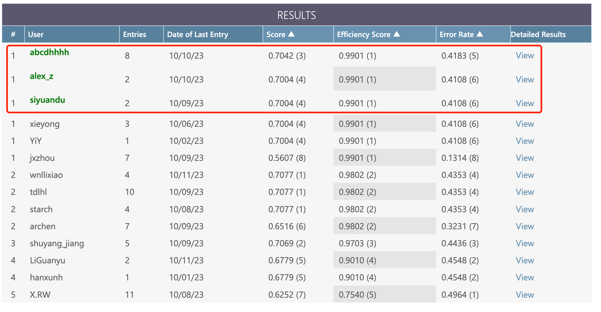
Adversarial Attack Competition
Link: https://codalab.lisn.upsaclay.fr/competitions/15669?secret_key=77cb8986-d5bd-4009-82f0-7dde2e819ff8

Slide 4
Adversarial Defense vs Detection
The weird relationship between defense and detection
Detection IS defense
But… when we say defense, we (most of the time) mean the model is secured, yet detection cannot do that…
In survey papers: detection is defense
In technical papers: defense is defense not detection
Differences
Defense is to secure the model or the system
Detection is to identify potential threats, which should be followed by a defense strategy, e.g., query rejection (but mostly ignored)
By defense, it mostly means robust training methods

Slide 5
Defense Methods
Early Defense Methods
Early Adversarial Training Methods
Later Adversarial Training Methods
Remaining Challenges and Recent Progress

Slide 6
A Recap of the Timeline
2014年Goodfellow等人提出快速单步攻击FGSM及对抗训练
2018年物理世界攻击方法、检测方法升级、PGD攻击与对抗训练、9种防御方法被攻破
2020年AutoAttack攻击、Fast对抗训练
2022年尚未解决的问题，攻击越来越多，防御越来越难
2016年提出对抗训练的min-max优化框架
2013年Biggio等人与Szegedy等人发现对抗样本
2015年简单检测方法（PCA）和对抗训练方法
2017年大量的对抗样本检测方法和攻击方法（BIM、C&W）、10种检测方法被攻破
2019年TRADES及大量其他对抗训练方法、第一篇Science文章
2021年增大模型、增加数据的对抗训练、领域延伸

Slide 7

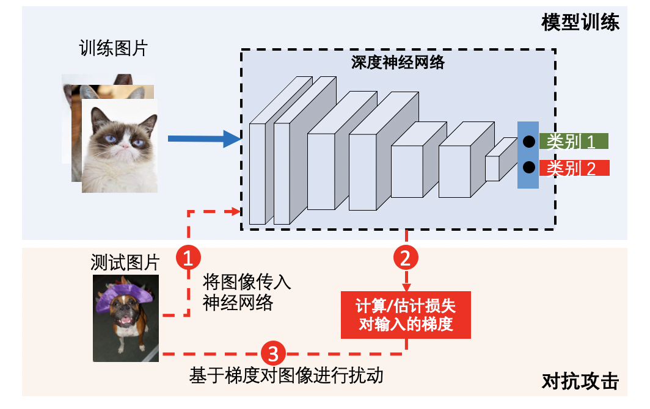

Principles of Defense
Block the attack (掐头去尾)
Mask the input gradients
Regularize the input gradients
Distill the logits
Denoise the input
Robustify the model (增强中间)
Smooth the decision boundary
Reduce the Lipschitzness of the model
Smooth the loss landscape

Slide 8
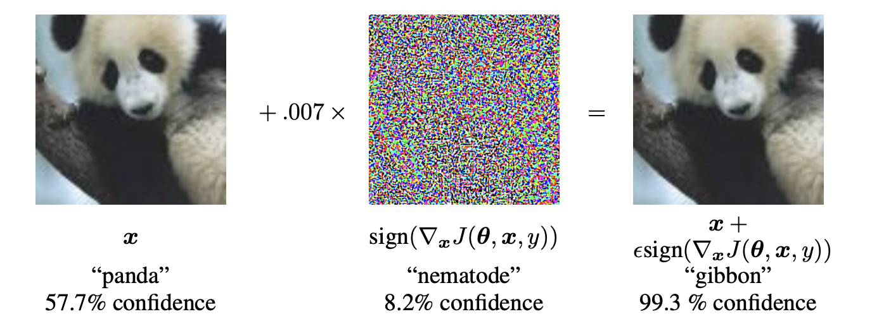
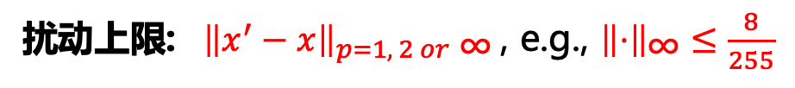
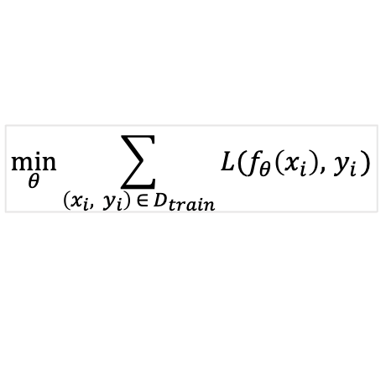
Adversarial Attack
$$\min_{θ}{\sum_{\left(x_{i}, y_{i}\right) ∈{ D}_{train}}{L(f_{θ}\left(x_{i}\right), { y}_{i})}}$$
模型训练:
对抗攻击:
$$\max_{x^{′}}{L(f_{θ}\left(x^{′}\right),y)} subject to {\left\|x^{′}−x\right\|}_{p}≤ε for x∈D_{test}$$
分类错误
扰动很小
测试阶段攻击
扰动上限: ${ \left\|x^{′}−x\right\|}_{p=1, 2 or\text{ ∞}}$, e.g., ${\left\|⋅\right\|}_{\text{∞}}≤\frac{8}{255}$
Szegedy C, Zaremba W, Sutskever I, et al. Intriguing properties of neural networks[J]. ICLR 2014.
Goodfellow I J, Shlens J, Szegedy C. Explaining and harnessing adversarial examples[J]. ICLR 2015.

Slide 9
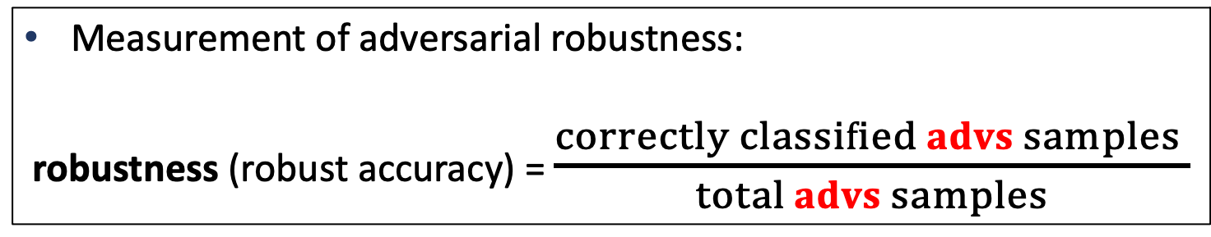
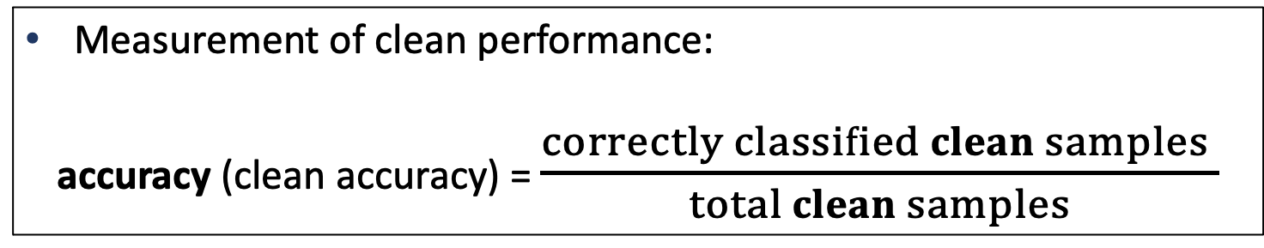
Performance Metrics
Measurement of clean performance:
accuracy (clean accuracy) = $\frac{correctly classified clean samples }{total clean samples}$
Measurement of adversarial robustness:
robustness (robust accuracy) = $\frac{correctly classified advs samples }{total advs samples}$
Other metrics: maximum perturbation for 100% attack success rate

Slide 10
Defense Methods
Early Defense Methods
Early Adversarial Training Methods
Advanced Adversarial Training Methods
Remaining Challenges and Recent Progress

Slide 11
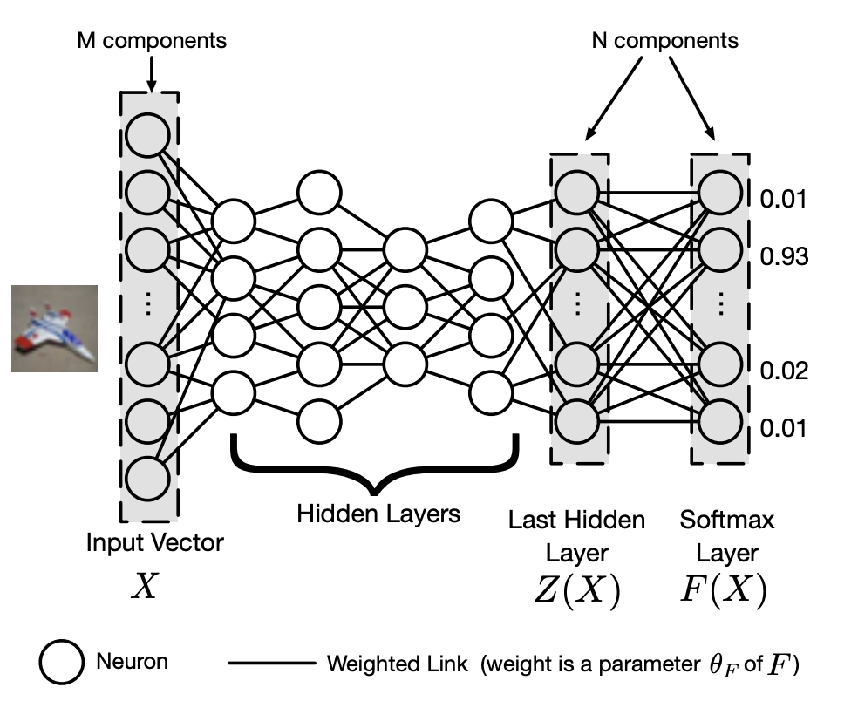
Defensive Distillation
Making large logits change to be ”small”
Scaling up logits by a few magnitudes;
Retrain the last layer with scaled logits;
Papernot et al. Distillation as a defense to adversarial perturbations against deep neural networks, S&P, 2016

Slide 12
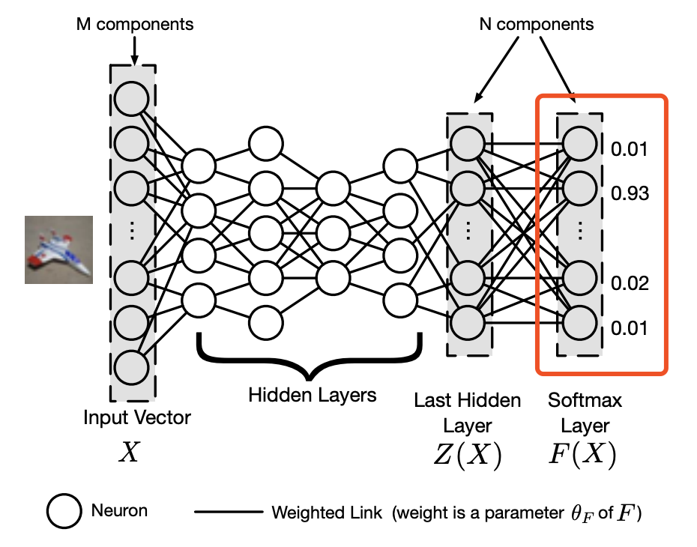
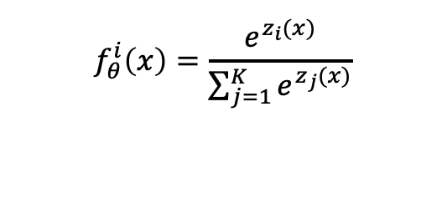
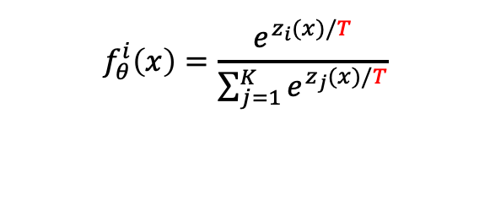
Defensive Distillation
$$f_{θ}^{i}\left(x\right)=\frac{e^{z_{i}(x)}}{\sum_{j=1}^{K}{e^{z_{j}(x)}}}$$
1
Distillation with
temperature T
$$f_{θ}^{i}\left(x\right)=\frac{e^{z_{i}(x)/T}}{\sum_{j=1}^{K}{e^{z_{j}(x)/T}}}$$
2
Papernot et al. Distillation as a defense to adversarial perturbations against deep neural networks, S&P, 2016

Slide 13
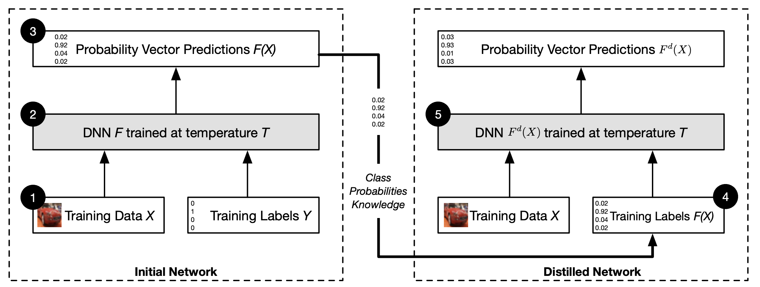
Defensive Distillation
Papernot et al. Distillation as a defense to adversarial perturbations against deep neural networks, S&P, 2016

Slide 14
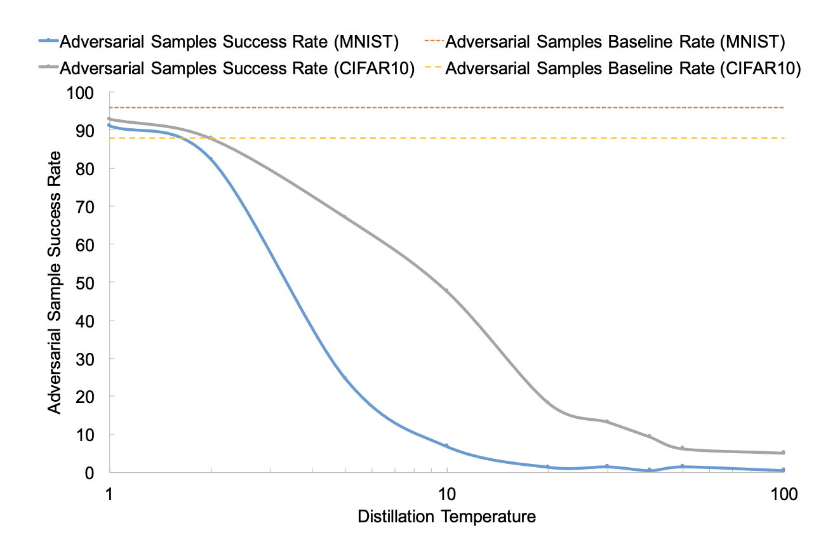
Defensive Distillation
Papernot et al. Distillation as a defense to adversarial perturbations against deep neural networks, S&P, 2016

Slide 15
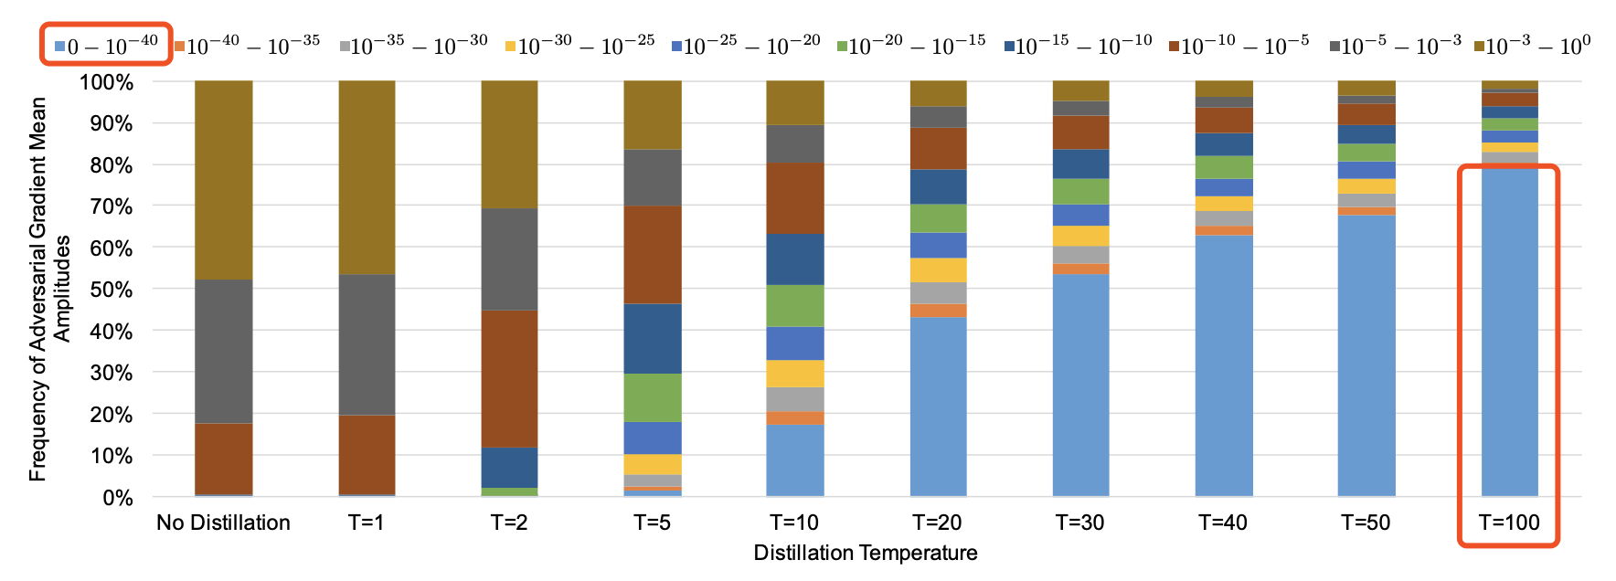
Defensive Distillation
Distillation makes input gradients $∇_{x} L(f_{θ}\left(x\right),y)$ to be small!
Papernot et al. Distillation as a defense to adversarial perturbations against deep neural networks, S&P, 2016

Slide 16
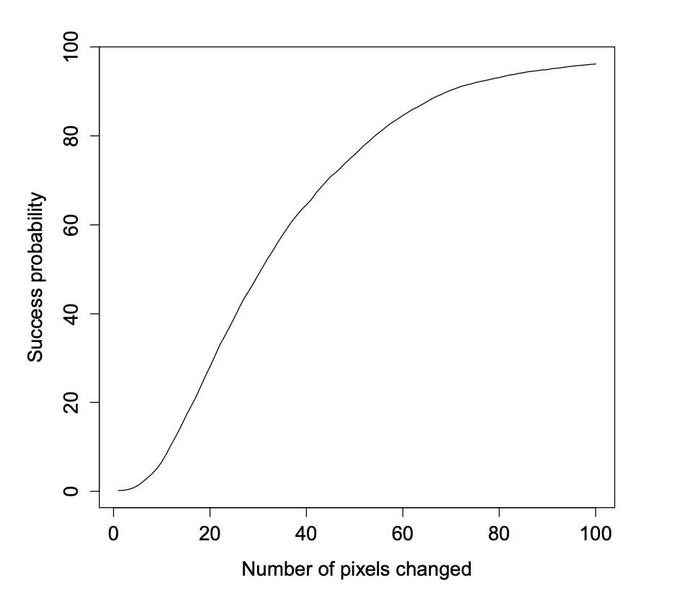
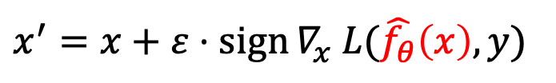
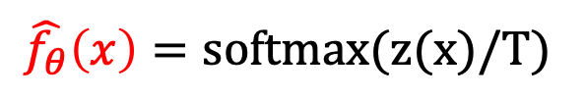
Defensive Distillation Is Not Robust
It can be evaded by attacking the distilled network with the temperature T.
$$x^{′}=x+ε⋅\operatorname{sign}{∇_{x} L(\hat{f_{θ}}\left(x\right),y)}$$
$$\hat{f_{θ}}\left(x\right)=softmax(z(x)/T)$$
Carlini, Nicholas, and David Wagner. "Defensive distillation is not robust to adversarial examples." arXiv preprint arXiv:1607.04311 (2016).

Slide 17
Lessons Learned
Distillation is not a good solution for adversarial robustness
Vanishing input gradients can still be recovered by a reverse operation
A defense should be evaluated against the adaptive attack to prove real robustness
Carlini, Nicholas, and David Wagner. "Defensive distillation is not robust to adversarial examples." arXiv preprint arXiv:1607.04311 (2016).

Slide 18
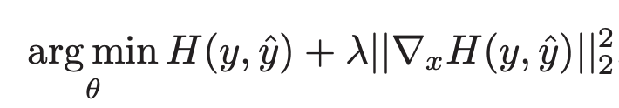
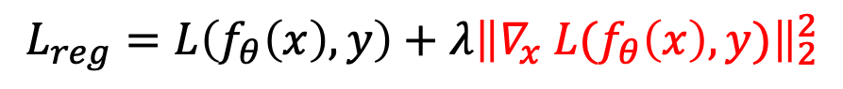
Input Gradients Regularization
Directly regularize the input gradients $∇_{x} L(f_{θ}\left(x\right),y)$ to be small
$$L_{reg}=L\left(f_{θ}\left(x\right),y\right)+λ{\left\|∇_{x} L(f_{θ}\left(x\right),y)\right\|}_{2}^{2}$$
Classification loss
Input gradients regularization
Related to the double backpropagation proposed by Drucker and Le Cun (1992):
Ross et al. "Improving the adversarial robustness and interpretability of deep neural networks by regularizing their input gradients." AAAI, 2018.
Drucker, Harris, and Yann Le Cun. “Improving generalization performance using double backpropagation.” TNN,1992.

Slide 19
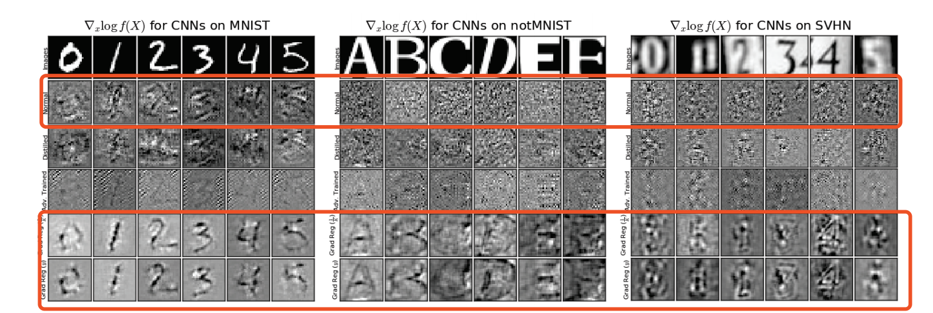
Input Gradients Regularization
蒸馏的
对抗训练的
正则化的
Issues: 1) limited adversarial robustness, 2) hurts learning
Ross et al. "Improving the adversarial robustness and interpretability of deep neural networks by regularizing their input gradients." AAAI, 2018.

Slide 20
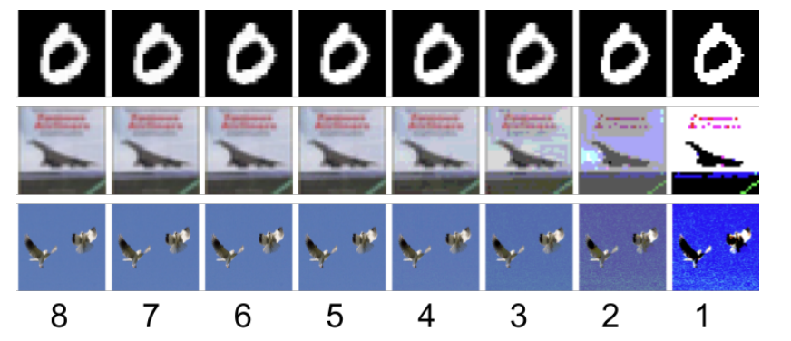
Feature Squeezing
Compress the input space
It also hurts performance on large-scale image datasets.
Xu et al. "Feature squeezing: Detecting adversarial examples in deep neural networks." NDSS, 2018.
Notes:
对于黑白图像（即二值图像），一个像素点用一个bit表示即可，即用0和1表示黑白。 这样一个字节可以表示8个像素。 2.对于灰度图，一个像素要求256种状态，即2的8次方，因此需要8bit，即1个byte表示一个像素

Slide 21
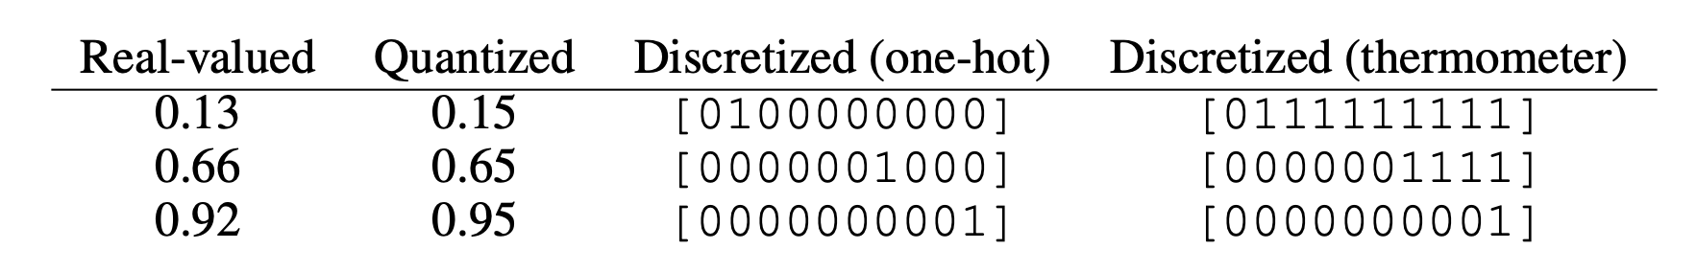
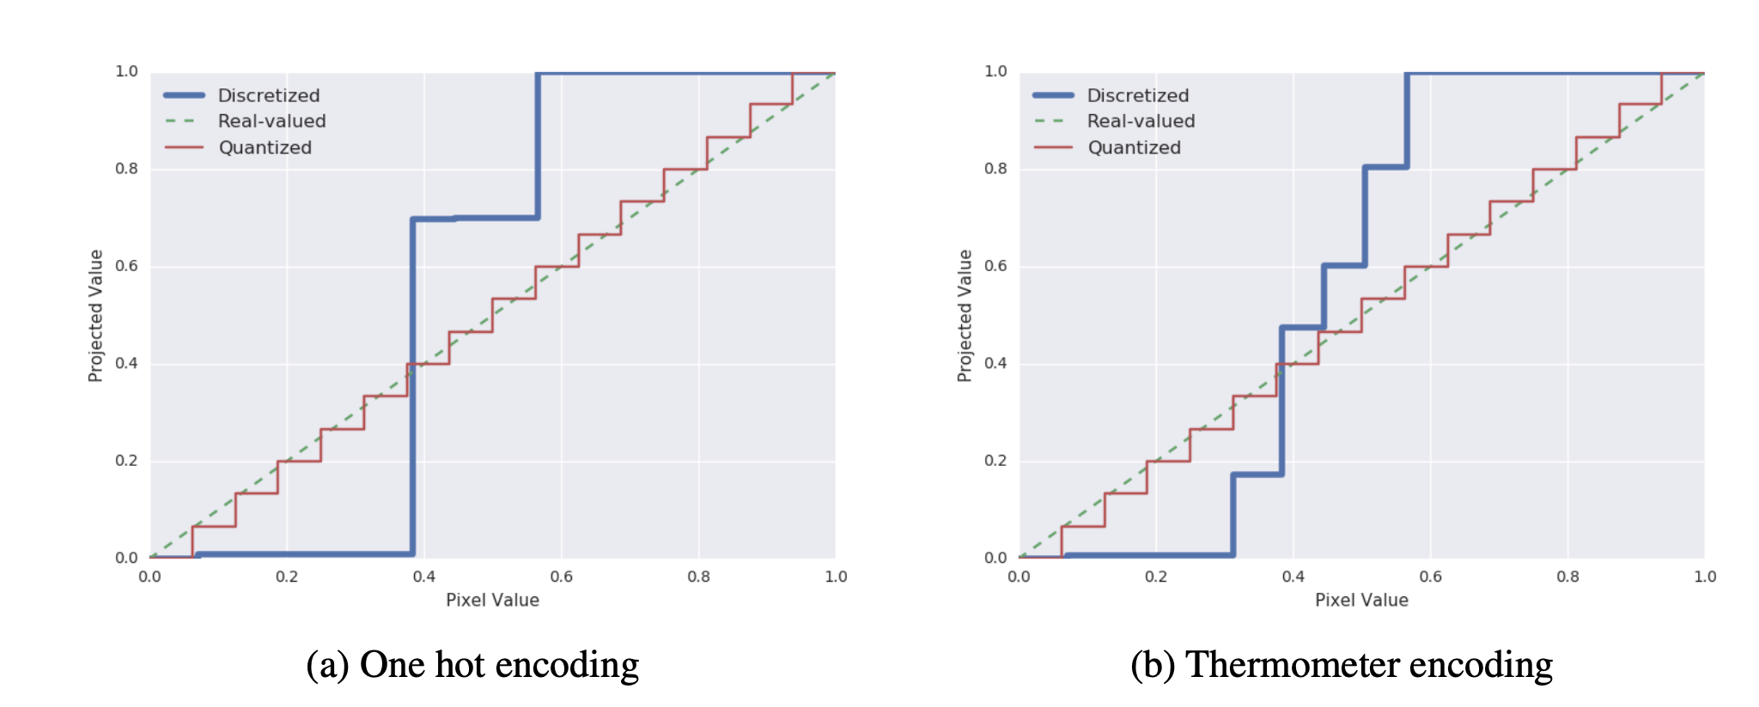
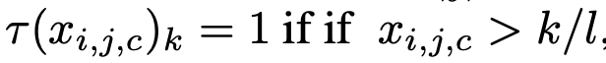
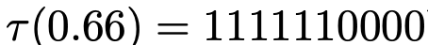
Thermometer Encoding
Discretize the input to break small noise
Proposed Thermometer Encoding
Buckman et al. "Thermometer encoding: One hot way to resist adversarial examples." ICLR, 2018.

Slide 22
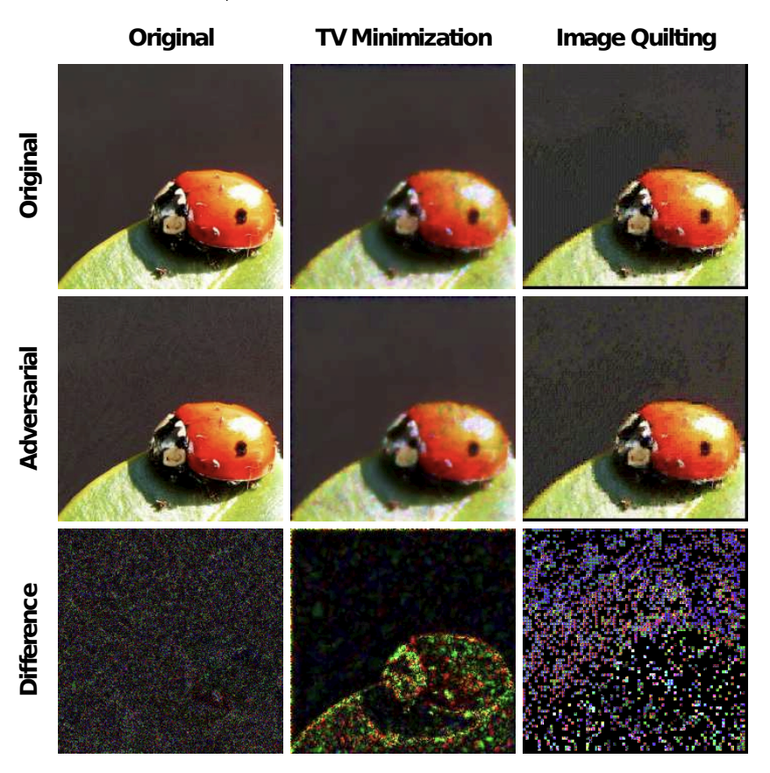
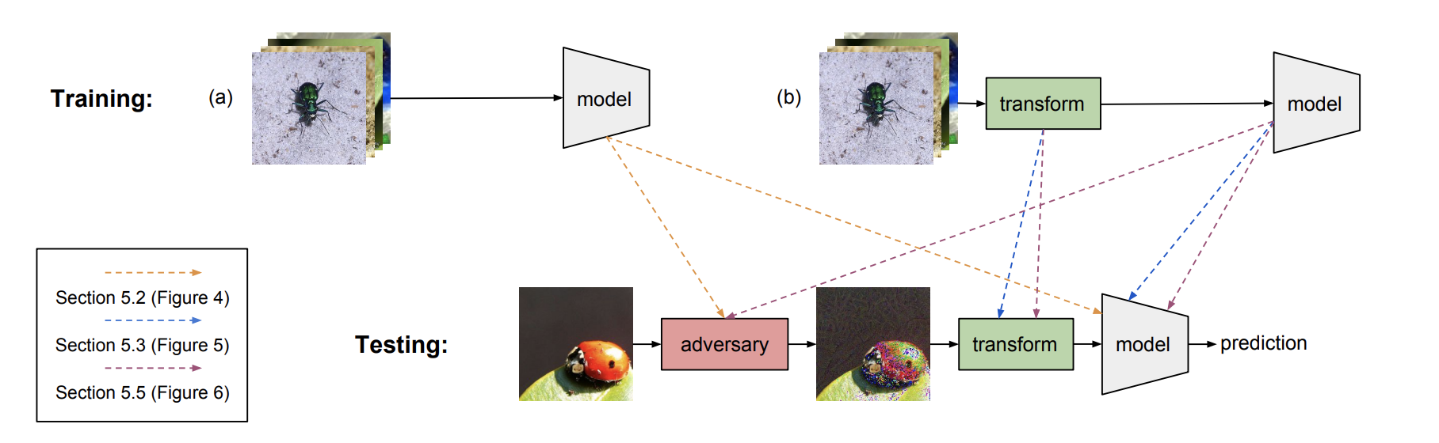
Input Transformations
Image cropping and rescaling
Bit-depth reduction
JPEG compression
Total variance minimization
Image quilting
Guo et al. "Countering Adversarial Images using Input Transformations." ICLR, 2018.

Slide 23
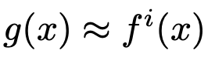
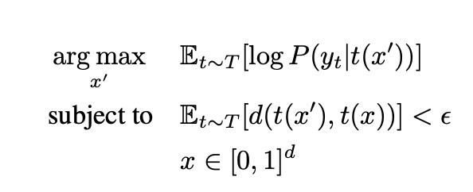
Obfuscated Gradients = Fake Robustness
Backward Pass Differentiable Approximation (BPDA):
can break non-differentiable operation based defenses
find a linear approximation of the non-differentiable operations, e.g., discretization, compression etc.
Expectation Over Transformation (EOT)
can break randomization based defenses
T: a set of randomized transformations
Athalye et al. “ Obfuscated Gradients Give a False Sense of Security: Circumventing Defenses to Adversarial Examples.” ICML, 2018.
Athalye et al. Synthesizing robust adversarial examples. ICML, 2018.

Slide 24
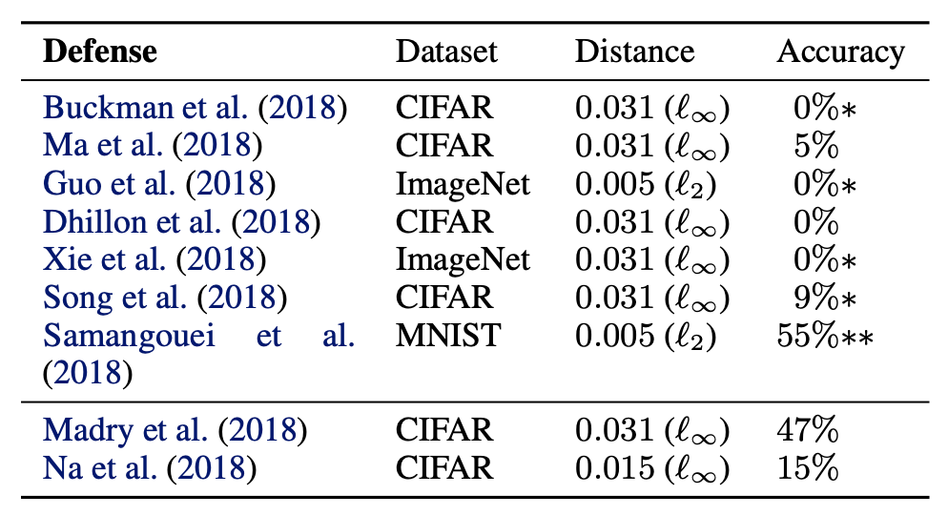
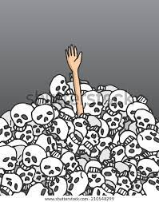
BPDA+EOT breaks 7 defenses published at ICLR 2018
We got a survivor!
Athalye et al. “ Obfuscated Gradients Give a False Sense of Security: Circumventing Defenses to Adversarial Examples.” ICML, 2018.
Athalye et al. Synthesizing robust adversarial examples. ICML, 2018.

Slide 25

How to Properly Evaluate a Defense?
Do not blindly apply multiple (similar) attacks
Try at least one gradient-free attack and one hard-label attack
Perform a transferability attack using a similar substitute model.
For randomized defenses, properly ensemble over randomness
For non-differentiable components, apply differentiable techniques (BPDA)
Verify that the attacks have converged under the selected hyperparameters
Carefully investigate attack hyperparameters and report those selected
Compare against prior work and explain important differences
Test broader threat models when proposing general defenses
Carlini, Nicholas, et al. “On evaluating adversarial robustness.” arXiv preprint arXiv:1902.06705 (2019). Athalye et al. “ Obfuscated Gradients Give a False Sense of Security: Circumventing Defenses to Adversarial Examples.” ICML, 2018

Slide 26
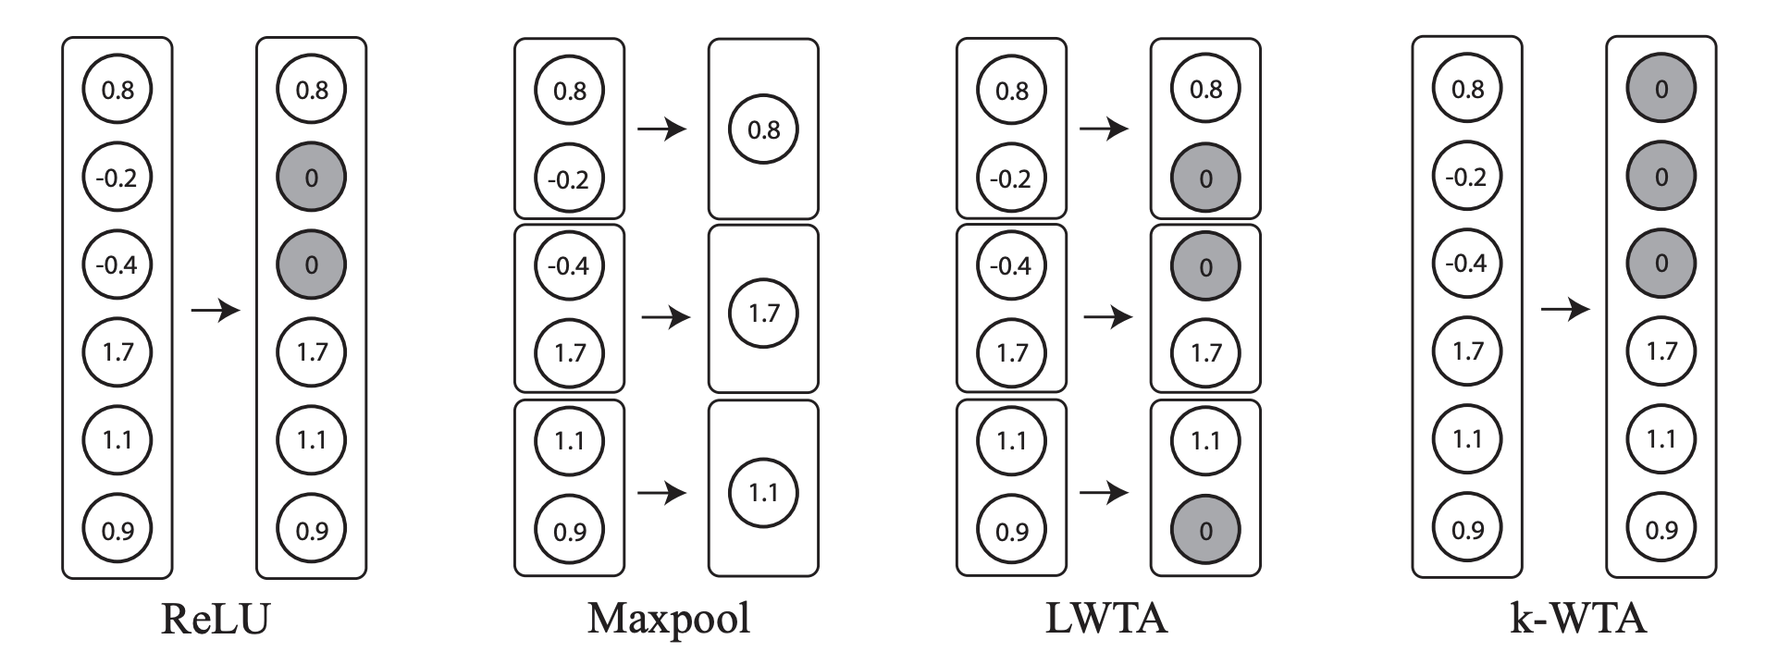
Robust Activation Functions
Block the internal activation: break the continuity
k-Winners-Take-All (k-WTA) activation
Xiao et al. "Enhancing Adversarial Defense by k-Winners-Take-All." ICLR, 2020.

Slide 27
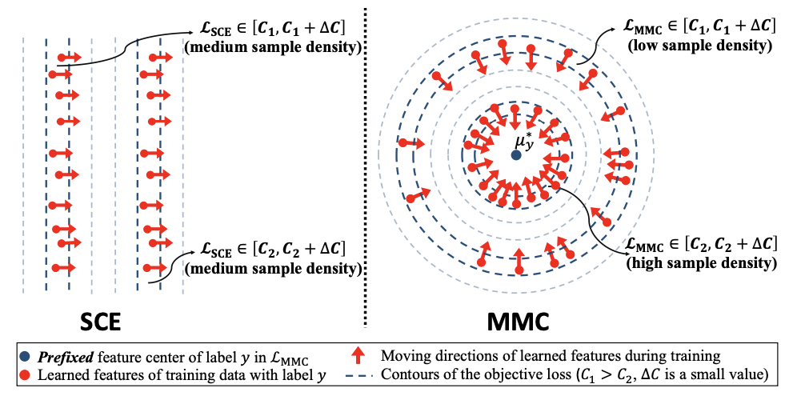
Robust Loss Function
Max-Mahalanobis center (MMC) loss
Max-Mahalanobis center (MMC); SCE: softmax cross entropy
Pang et al. Rethinking softmax cross-entropy loss for adversarial robustness. ICLR, 2020.

Slide 28
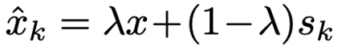
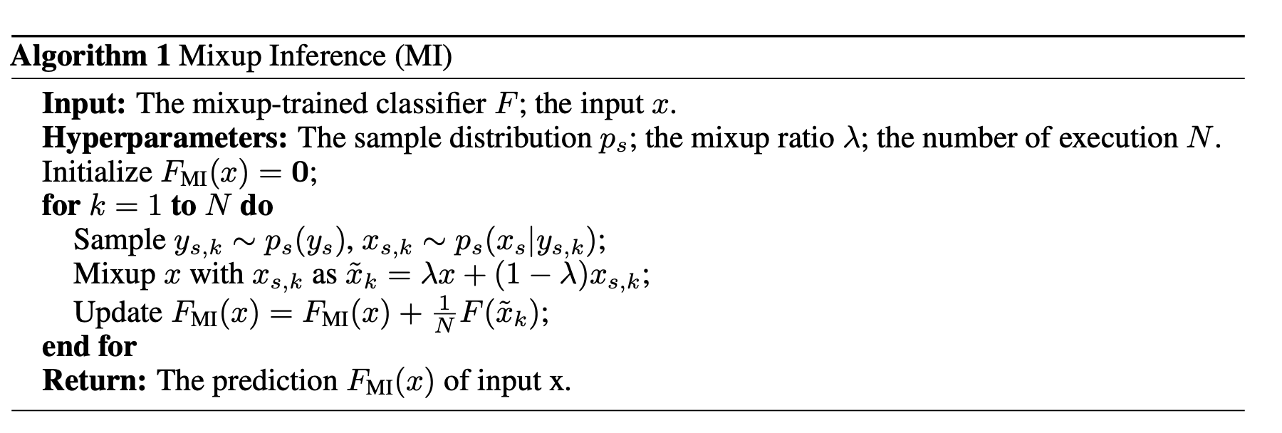
Robust Inference
Mixup Inference (MI)
Pang et al. Mixup Inference: Better exploiting mixup to defend adversarial attacks. ICLR, 2020.

Slide 29
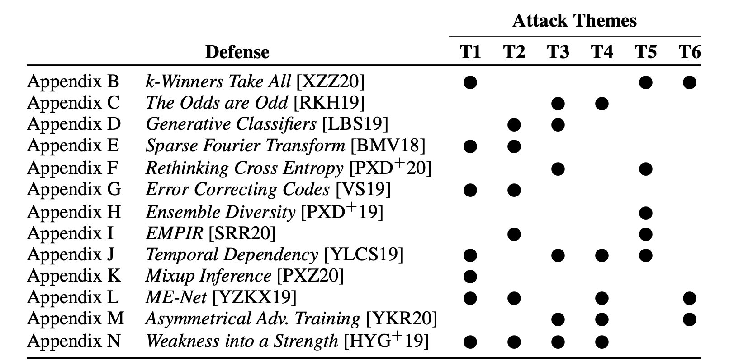
New Adaptive Attacks Break These Defenses
T1: Attack the full defense
T2: Target important defense parts
T3: Simplify the attack
T4: Ensure consistent loss function
T5: Optimize with different methods
T6: Use strong adaptive attacks
Tramer et al. “On adaptive attacks to adversarial example defenses.” NeurIPS, 2020.

Slide 30
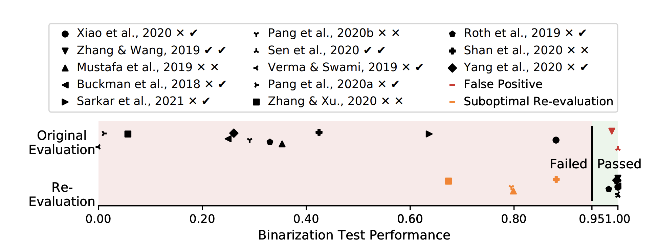
How to Evaluate a Defense?
Strong attacks:
AutoAttack (one must-to-test attack)
Margin Decomposition (MD) attack (better than AutoAttack on ViT)
Minimum-Margin (MM) attack (new SOTA attack to test?)
Extra robustness tests
Attack unit tests (Zimmermann et al, 2022)
Croce and Hein. “Reliable evaluation of adversarial robustness with an ensemble of diverse parameter-free attacks.” ICML, 2020.
Gao et al. Fast and Reliable Evaluation of Adversarial Robustness with Minimum-Margin Attack, ICML 2022.
Zimmermann et al. "Increasing Confidence in Adversarial Robustness Evaluations." arXiv preprint arXiv:2206.13991 (2022).

Slide 31
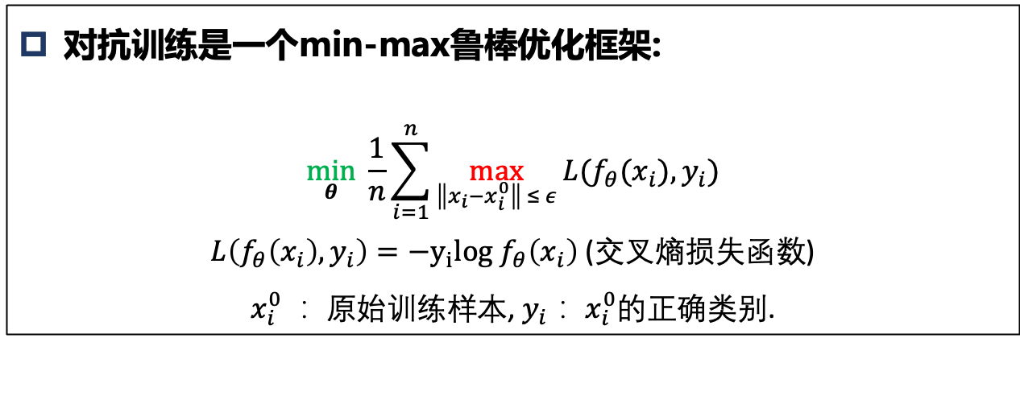
Adversarial Training
The idea is simple: just train on adversarial examples!
对抗训练是一种数据增广方法
原始数据-> 对抗攻击-> 对抗样本->模型训练
对抗训练是一个min-max鲁棒优化框架:
$$\min_{θ}{ \frac{1}{n}}\sum_{i=1}^{n}{\max_{\left\|x_{i}−x_{i}^{0}\right\| ≤ ε}{L(f_{θ}(x_{i}), y_{i})}}$$
$L\left(f_{θ}\left(x_{i}\right), y_{i}\right)={−y}_{i}log$ $f_{θ}\left(x_{i}\right)$ (交叉熵损失函数)
$x_{i}^{0}$： 原始训练样本, $y_{i}$： $x_{i}^{0}$的正确类别.
Goodfellow I J, Shlens J, Szegedy C. Explaining and harnessing adversarial examples[J]. ICLR 2015.

Slide 32
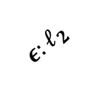

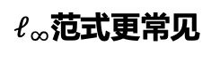
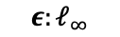

Adversarial Training
在以$x$为中心的 $ε$-球范围内寻找对抗性最强的样本
$$ε:ℓ_{2}$$
$$ε:ℓ_{∞}$$
$$x$$
$$x$$
$ℓ_{∞}$范式更常见

Slide 33
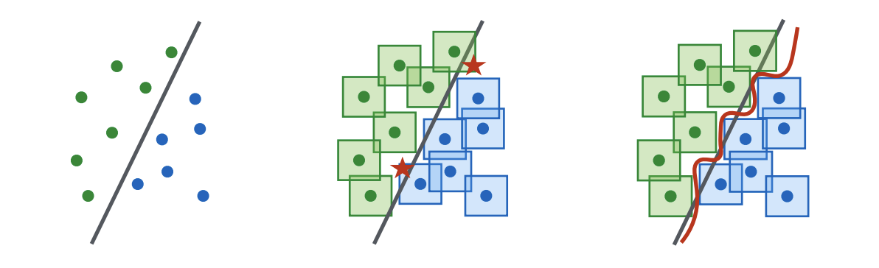
Adversarial Training
Adversarial training produces smooth decision boundary
正常边界
生成对抗样本
训练后

Slide 34
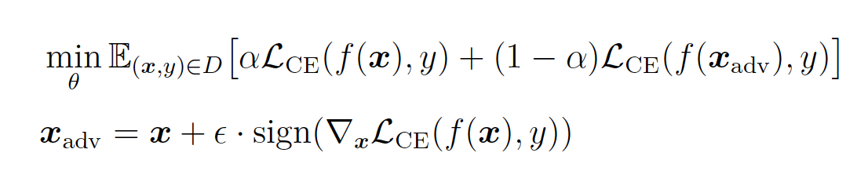
Early Adversarial Training Methods
2014年， Szegedy et al. 在其解释对抗样本的论文中已探索了对抗训练，用L-BFGS攻击对神经网络每一层生成对抗样本，并添加到训练过程中。
发现：深层对抗样本更能提高鲁棒性
2015年，Goodfellow et al. 提出使用FGSM（单步）攻击生成的对抗样本来训练神经网络
Goodfellow等人并未使用中间层的对抗样本，因为发现中间层对抗样本没有提升
Szegedy C, Zaremba W, Sutskever I, et al. Intriguing properties of neural networks[J]. ICLR 2014.
Goodfellow I J, Shlens J, Szegedy C. Explaining and harnessing adversarial examples[J]. ICLR 2015.

Slide 35
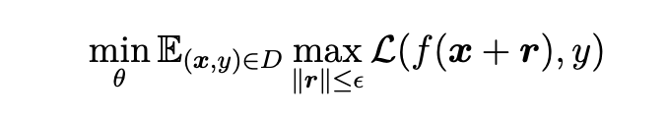
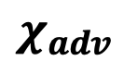
Min-max Robust Optimization
The First Proposal of Min-Max Optimization
$$χ_{adv}$$
外部最小化
Outer minimization
内部最大化
Inner maximization
Nokland et al. Improving back-propagation by adding an adversarial gradient. arXiv:1510.04189, 2015.
Huang et al. Learning with a strong adversary, ICLR 2016. Shaham et al. Understanding adversarial training: Increasing local stability of neural nets through robust optimization, arXiv:1511.05432, 2015

Slide 36
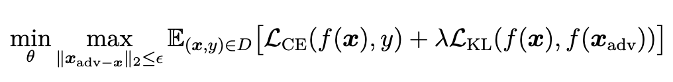
Virtual Adversarial Training
VAT: a method to improve generalization
Differences to adversarial training
L2 regularized perturbation
Use both clean and adv examples for training
Use KL divergence to generate adv examples
Miyato et al. Distributional smoothing with virtual adversarial training. ICLR 2016.

Slide 37
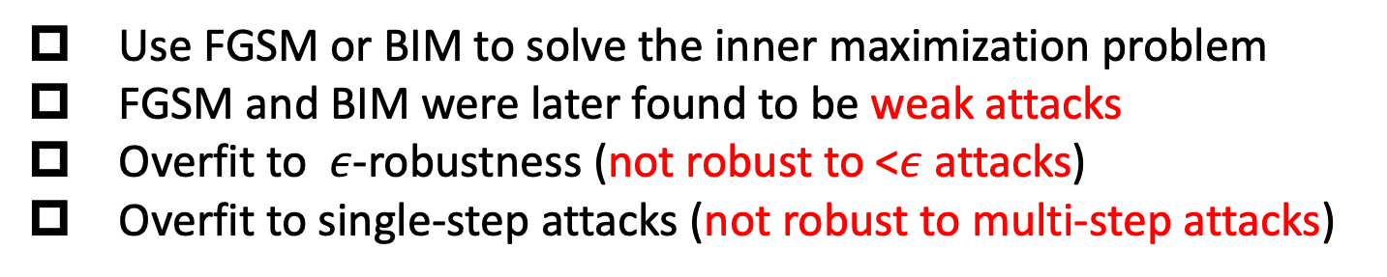
Weaknesses of Early AT Methods
Use FGSM or BIM to solve the inner maximization problem
FGSM and BIM were later found to be weak attacks
Overfit to $ε$-robustness (not robust to <$ε$ attacks)
Overfit to single-step attacks (not robust to multi-step attacks)
These methods are fast! Only takes x2 time of standard training
Miyato et al. Distributional smoothing with virtual adversarial training. ICLR 2016.

Slide 38
PGD Adversarial Training
We got a survivor!
Athalye et al. “ Obfuscated Gradients Give a False Sense of Security: Circumventing Defenses to Adversarial Examples.” ICML, 2018.
Athalye et al. Synthesizing robust adversarial examples. ICML, 2018.

Slide 39
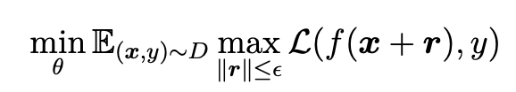
PGD Adversarial Training
A Saddle Point Problem
外部最小化
Outer minimization
内部最大化
Inner maximization
A saddle point (constrained bi-level optimization) problem
In constrained optimization, Projected Gradient Descent (PGD) is the best first-order solver
Madry et al. "Towards Deep Learning Models Resistant to Adversarial Attacks." ICLR. 2018.

Slide 40
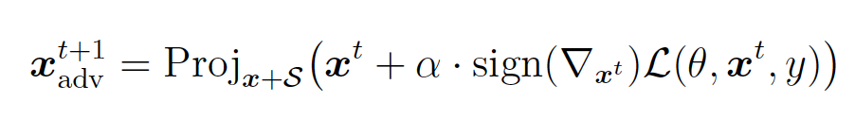





PGD Adversarial Training
Projected Gradient Descent (PGD)
$$x^{1}$$
$$x^{1}$$
$$x_{0}$$
Projection
$$x_{0}$$
(Clipping)
$$ε:ℓ_{∞}$$
$$ε:ℓ_{∞}$$
PGD is an optimizer
PGD is also known as an adv attack in the field of AML
Madry et al. "Towards Deep Learning Models Resistant to Adversarial Attacks." ICLR. 2018.

Slide 41





PGD Adversarial Training
Projected Gradient Descent (PGD)
$$x_{0}^{′}$$
$$x_{0}$$
+ Uniform Noise
$$x_{0}+δ∈[−ε,+ε]$$
$$ε:ℓ_{∞}$$
$$ε:ℓ_{∞}$$
Random initialization
Madry et al. "Towards Deep Learning Models Resistant to Adversarial Attacks." ICLR. 2018.

Slide 42

PGD Adversarial Training
Characteristics of PGD adversarial training
只在对抗样本上训练模型
通用鲁棒性：< $ε$鲁棒性和多步攻击鲁棒性
需要大容量模型
需要更多训练数据
对抗训练会产生平滑的决策边界
对抗训练会对内部激活产生一种截断效果
对抗训练会强制模型学习鲁棒特征
鲁棒性提升的同时干净准确率会下降
训练很耗时，相当于5-10倍普通训练
Madry et al. “Towards Deep Learning Models Resistant to Adversarial Attacks.” ICLR. 2018.
Ilyas et al. “Adversarial examples are not bugs, they are features.” NeurIPS, 2019.

Slide 43

PGD Adversarial Training
决策边界：
普通训练
对抗样本
对抗训练
普通训练
鲁棒特征：
对抗训练
Madry et al. “Towards Deep Learning Models Resistant to Adversarial Attacks.” ICLR. 2018.
Ilyas et al. “Adversarial examples are not bugs, they are features.” NeurIPS, 2019.

Slide 44




Dynamic Adversarial Training (DART)
PGD步长对鲁棒性影响
PGD步数对鲁棒性影响
训练初期使用简单攻击
对于10步对抗训练（PGD-10 Adversarial Training）来说:
最优步长是$ε/2$和$ε/4$
步数影响不大，只要足够探索到$ε$-ball的边界
训练初期使用弱对抗样本反而会提高鲁棒性
Wang et al. “On the Convergence and Robustness of Adversarial Training.” ICML. 2019.

Slide 45


Dynamic Adversarial Training (DART)
How to measure the convergence of the inner maximization?
Definition ( First-Order Stationary Condition (FOSC))
Given a sample $x^{0}∈X$, let $x^{k}$ be an intermediate example found at the $k^{th}$ step of the inner maximization. The First-Order Stationary Condition of $x^{k}$ is: $$c\left(x^{k}\right)=\max_{x∈χ}\left\langle x−x^{k}, ∇_{x}f(θ, x^{k})\right\rangle ,$$ where $Χ=\left\{x|{\left\|x−x^{0}\right\|}_{∞}≤ ε\right\}$ is the input domain of the $ε$-ball around normal example $x^{0}$, $f\left(θ, x^{k}\right)=ℓ(h_{θ}(x^{k}, y)$, and $\left\langle ⋅\right\rangle$ is the inner product.
FOSC:
Inspired by the Frank-Wolfe gap for constrained min-max optimization.
Smaller value of $c\left(x^{k}\right)$ indicates better convergence of the inner maximization.
It has a close-form solution, affine invariant and norm independent.
Wang et al. “On the Convergence and Robustness of Adversarial Training.” ICML. 2019.

Slide 46


Dynamic Adversarial Training (DART)
Dynamic Adversarial Training:
Weak attack for early training, strong attack for later training
Weak attack improves generalization, strong attack improves final robustness.
Convergence analysis:
Robustness on CIFAR-10 with WideResNet
DART improves robustness
Wang et al. “On the Convergence and Robustness of Adversarial Training.” ICML. 2019.

Slide 47


TRADES
Use distribution loss (KL) for inner and outer optimizations
Zhang et al. "Theoretically principled trade-off between robustness and accuracy." ICML, 2019.

Slide 48
TRADES
Characteristics of TRADES
TRADES既改进了内部最大化又改进了外部最小化
使用KL监督对抗样本的生成，鲁棒性提升显著
干净样本也参与训练，有利于模型收敛和干净准确率
基于KL的对抗样本生成包含自适应的过程
能成训练得到比PGD对抗训练更平滑的决策边界
Winning solutions of NeurIPS 2018 Adversarial Vision Challenge
Zhang et al. "Theoretically principled trade-off between robustness and accuracy." ICML, 2019.

Slide 49

TRADES
Experimental results of TRADES
Zhang et al. "Theoretically principled trade-off between robustness and accuracy." ICML, 2019.

Slide 50
TRADES vs VAT vs ALP
TRADES:
Virtual Adversarial Training:
Adversarial Logits Pairing:
相似的优化框架，不同的损失选择，结果差异很大
Zhang et al. "Theoretically principled trade-off between robustness and accuracy." ICML, 2019.
Miyato et al. Distributional smoothing with virtual adversarial training. ICLR 2016.
Kannan, Harini, Alexey Kurakin, and Ian Goodfellow. "Adversarial logit pairing." arXiv preprint arXiv:1803.06373 (2018).

Slide 51

MART: Misclassification Aware adveRsarial Training
Min-max Adversarial Training:
$\min_{θ}{\frac{1}{n}}\sum_{i=1}^{n}{\max_{\left\|x_{i}−x_{i}^{0}\right\| ≤ ε}{ℒ(f_{θ}(x_{i},) y_{i})}}$
where, $x_{i}^{0}$ is a natural (clean) training sample, $y_{i}$ is the label of $x_{i}^{0}$.
Adversarial examples are only defined on correctly classified examples, what about misclassified examples ?
Wang, et al. “Improving adversarial robustness requires revisiting misclassified examples.” ICLR, 2019.

Slide 52


MART: Misclassification Aware adveRsarial Training
The influence of misclassified and correctly classified examples:
A pre-trained network to select the same size (13%)
Subset of misclassified examples $S^{−}$
Subset of correctly classified examples $S^{+}$
Misclassified examples have a significant impact on the final robustness!
Wang, et al. “Improving adversarial robustness requires revisiting misclassified examples.” ICLR, 2019.

Slide 53




MART: Misclassification Aware adveRsarial Training
For inner maximization process:
Weak attack on misclassified examples $S^{−}$
Weak attack on correctly classified examples $S^{+}$
For outer minimization process:
Regularization on misclassified examples $S^{−}$
Regularization on correctly classified examples $S^{+}$
different maximization techniques have negligible effect
different minimization techniques have significant effect
Wang, et al. “Improving adversarial robustness requires revisiting misclassified examples.” ICLR, 2019.

Slide 54


MART: Misclassification Aware adveRsarial Training
Misclassification aware adversarial risk:
Adversarial risk:
Correctly classified and misclassified example:
Misclassification aware adversarial risk:

Slide 55



MART: Misclassification Aware adveRsarial Training
Surrogate loss functions (existing methods and MART):
Semi-supervised extension of MART:

Slide 56


MART: Misclassification Aware adveRsarial Training
Robustness of MART:
White-box robustness: ResNet-18, CIFAR-10, 𝜖=8/255
White-box robustness: WideResNet-34-10, CIFAR-10, 𝜖=8/255

Slide 57


Using More Data to Improve Robustness
80 Million Tiny Images
CIFAR-10
500K (10x)
Select (carefully) 100K/500K images into CIAFR-10
Alayrac et al. “Are labels required for improving adversarial robustness?.” NeurIPS, 2019.
Carmon et al. “Unlabeled data improves adversarial robustness.” NeurIPS 2019

Slide 58





UAT & RST
Unsupervised Adversarial Training (UAT):
Robust Self-Training (RST):
$\tilde{x_{i}}$: new samples
$\tilde{y_{i}}$: pseudo-labels
Alayrac et al. “Are labels required for improving adversarial robustness?.” NeurIPS, 2019.
Carmon et al. “Unlabeled data improves adversarial robustness.” NeurIPS 2019

Slide 59

State-of-the-art: AT Methods
数据，数据，还是数据！！
数据增广
数据生成
https://robustbench.github.io/

Slide 60


State-of-the-art: AT Methods
Clean accuracy: 94% vs 66% (robustness)
DNN: WideResNet-70-16; Dataset: CIFAR-10
Perturbation: $ε=8/255$;
Evaluation attack: AutoAttack
https://robustbench.github.io/

Slide 61

State-of-the-art: DNN Architecture
http://robust.art/
Tang et al. “RobustART: Benchmarking robustness on architecture design and training techniques.”arXiv:2109.05211, 2021.

Slide 62



State-of-the-art: DNN Architecture
Reduce the deep layers can improve robustness
d: depth
^{d}5-5-5：depth=5 at all 3 stages
WideResNet-34-10
Depth Grid Search
Huang et al. “Exploring architectural ingredients of adversarially robust deep neural networks.” NeurIPS 2021.

Slide 63






Certified Defense vs Empirical Defense
Certified robustness (Sinha et al. 2018; Cohen et al. 2018; Lee et al. 2019)
Gaussian randomized smoothing -> robustness with the $ℓ_{2}$ norm ball
Laplacian randomized smoothing -> $ℓ_{1}$ robustness
Uniform randomized smoothing -> $ℓ_{0}$ robustness
Pros: robustness guarantees，严格的鲁棒性下界证明
Cons: 1) deep networks are hard to certify, 2) guarantees are loose, 3) need to train the mode in certain ways
2D
$$ℓ_{∞}$$
$$ℓ_{1}$$
关键点：如何在神经网络里传播边界？
3D
$$ℓ_{2}$$
Convex hull:
$$ℓ_{∞}+ ℓ_{1}$$
Li et al. Sok: Certified robustness for deep neural networks, S&P, 2023

Slide 64
Existing Challenges
How to attack large language/vision/multi-model models
How to defend large language/vision/multi-model models
How to adapt adv training for different applications
How to reduce the cost of defense: acceleration, loss of clean acc
How to combine adv detection with adversarial training
How to include adv training into the pretraining/finetuning pipeline

Slide 65
谢谢！

